Slide 2
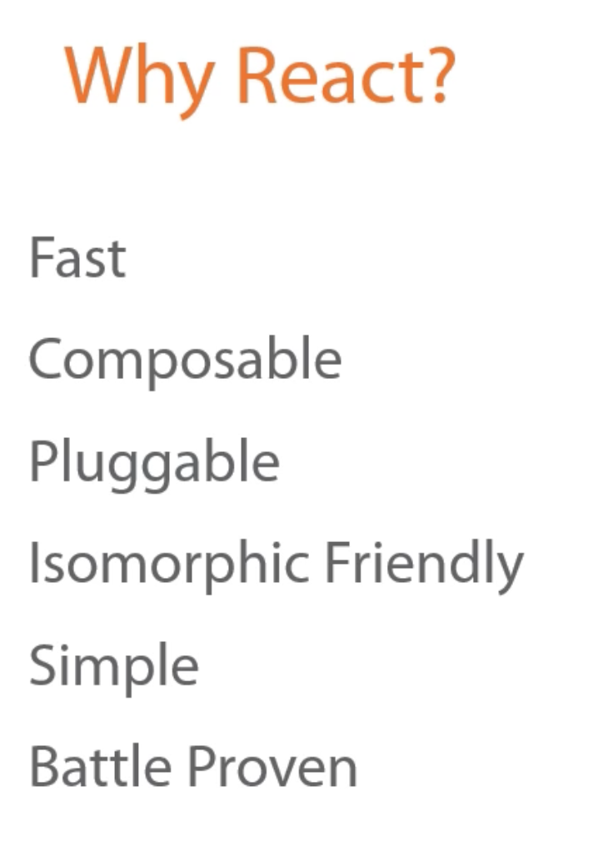
React is known for being extremely 'Fast' and Responsive
React can 'scale' to large and complex UI applications
because it's very efficient about how and when it manipulates the DOM
React is designed to help eliminate ‘Layout Thrash’ by using a Virtual DOM behind the scenes.
React offers a really simple model for composing Components.
You can easily nest components within other components and pass data down to child components via props.
These props look and operate very similar to simple HTML attributes.
Unlike larger full-featured frameworks like Angular and Ember, React is easily pluggable into existing applications.
Since it's just view layer, you can easily integrate it with other technologies.
We can just replace small piece with react component in big web application and see how it performs.
of course, we can create an entire app using React for the view layer
React components are Isomorphic Friendly.
This is a friendly way of saying that they can be rendered on both the client and the server.
Some call this Universal JavaScript.
React doesn't need the DOM to be able to render.
Isomorphic rendering can
increase perceived loading performance,
avoids repeating code on the client and the server,
and it offers a simple path to search engine optimization.
Since React is a very focused library, it's quite simple to learn, as you'll see.
The API is small and there aren't very many moving parts and concepts that you need to master.
Finally, React is Battle Proven.
It was created by Facebook and it's used extensively on Facebook.com (one of the highly trafficked websites in the world)
Not only Facebook uses React --> Netflix, Microsoft, Yahoo, Dropbox, The NewYork Times, Reddit, Paypal.

Slide 3
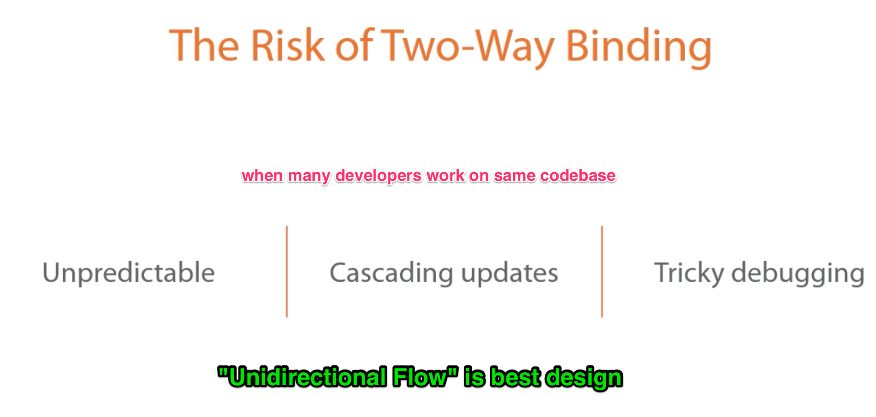

Slide 4
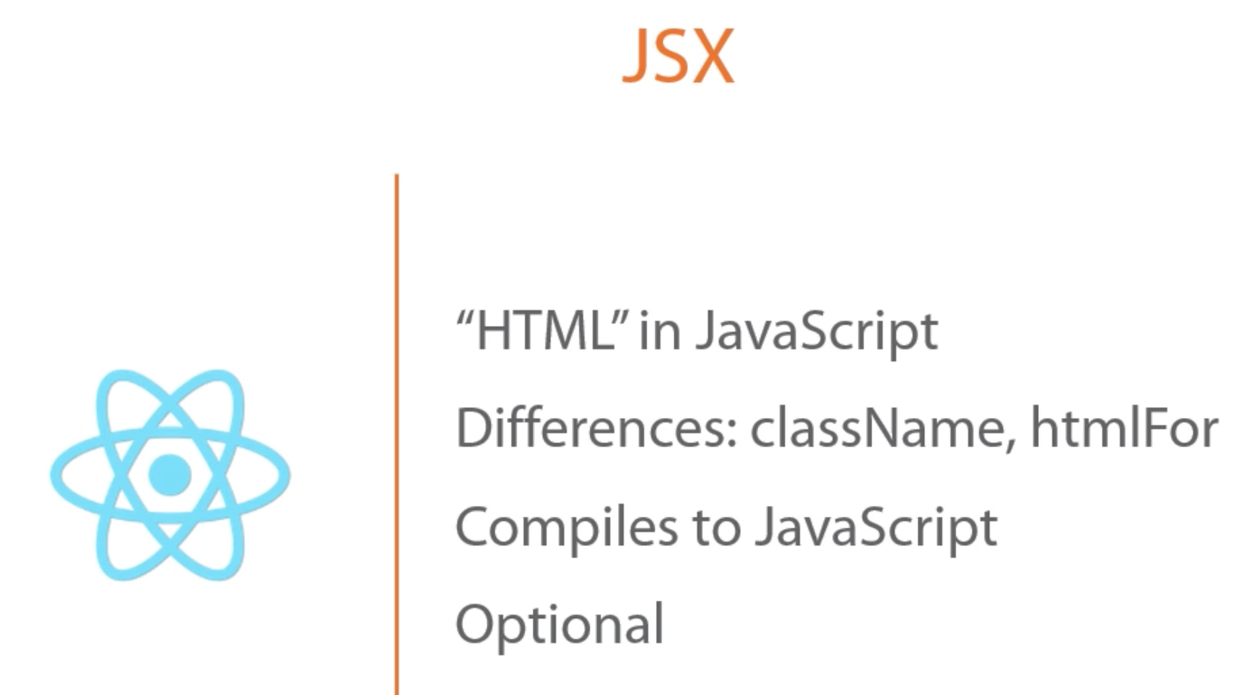

Slide 5
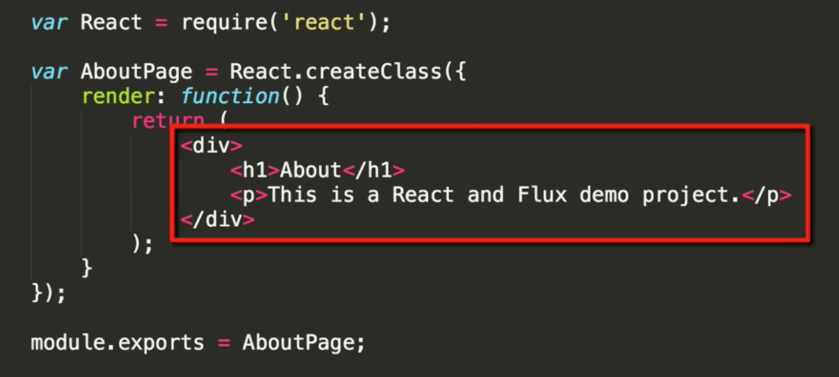
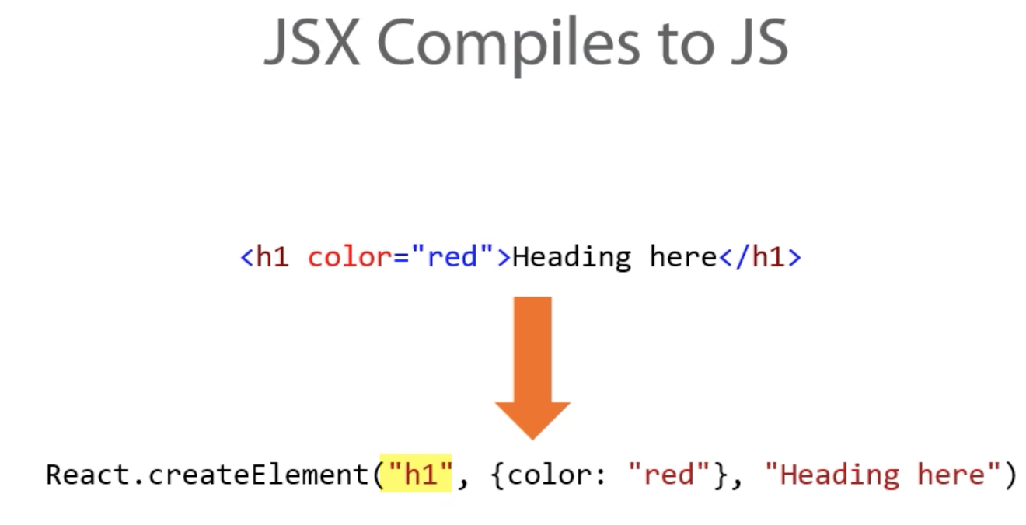

Slide 6
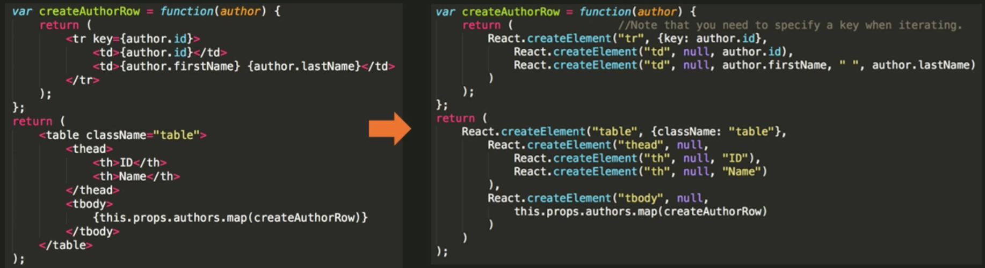

Slide 7


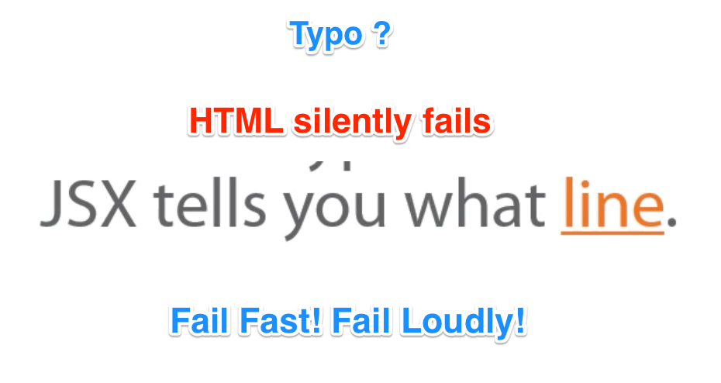

HTML and JavaScript intertwined technologies
JSX acknowledges the tight coupling of HTML and JavaScript

Slide 8
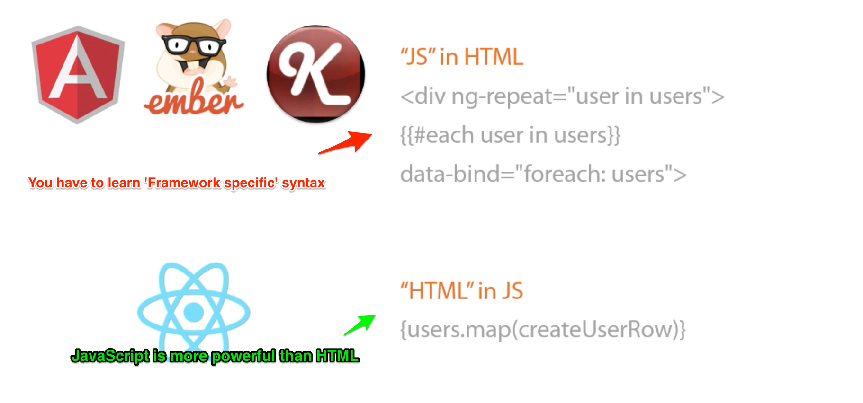

Slide 10
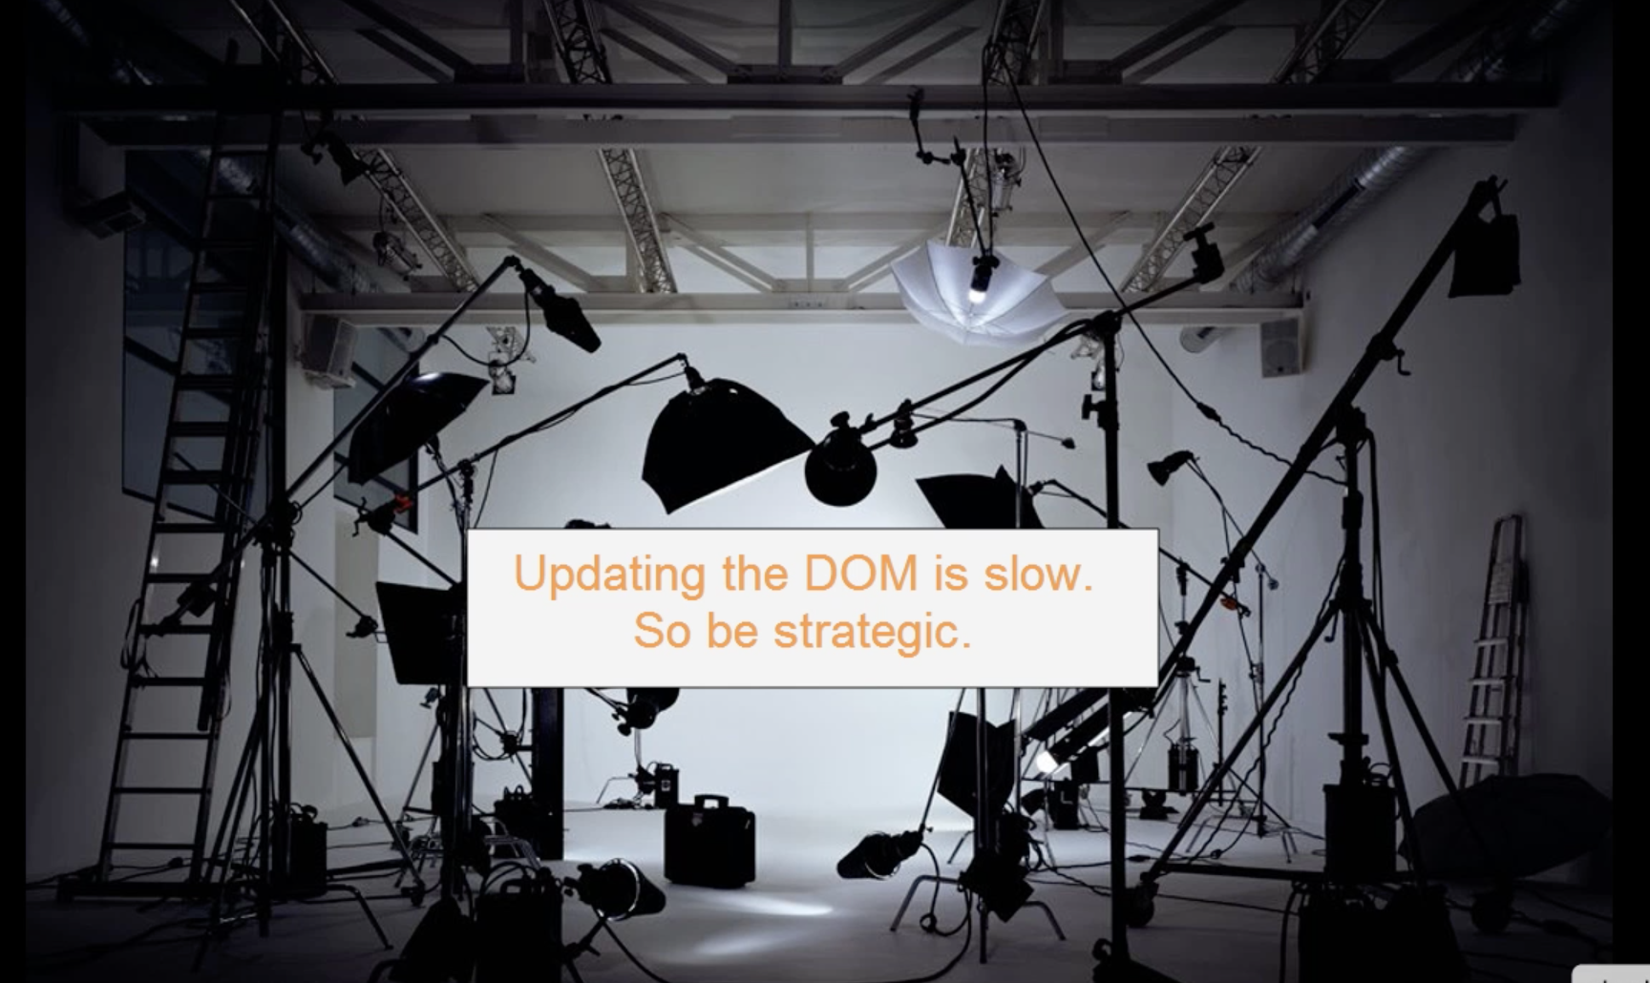
Why Virtual DOM ?

Slide 11


Slide 12


Slide 13
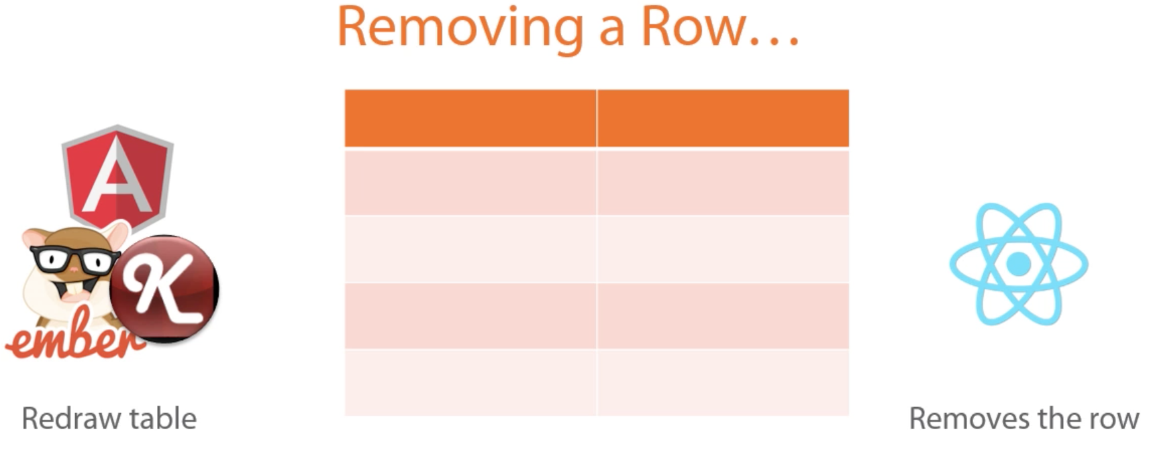

Slide 14
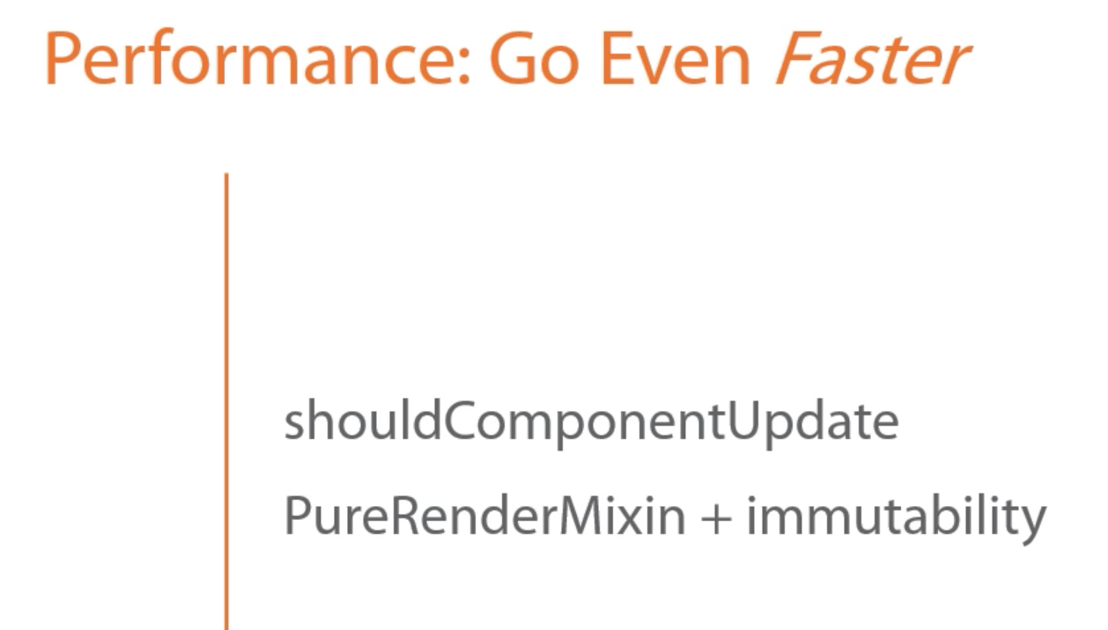
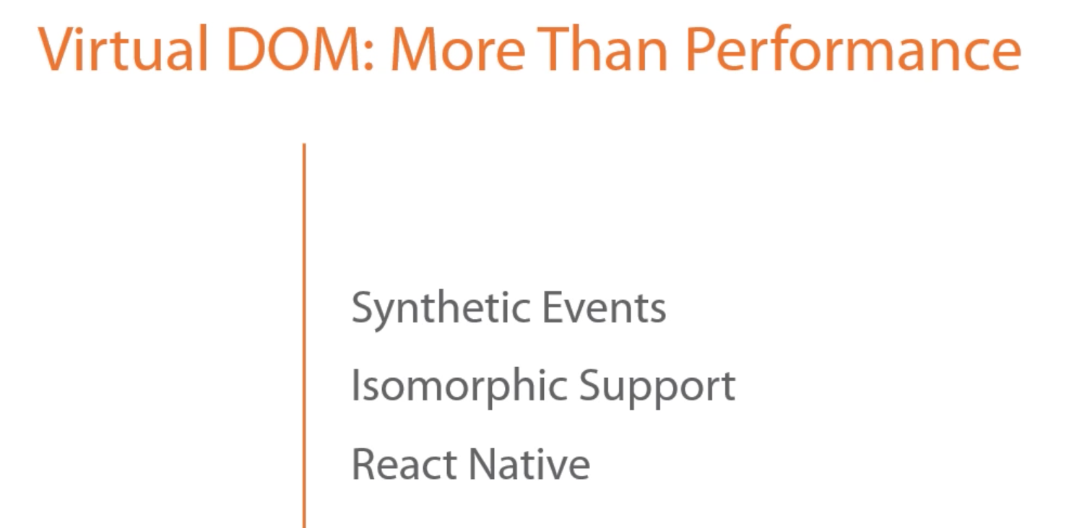
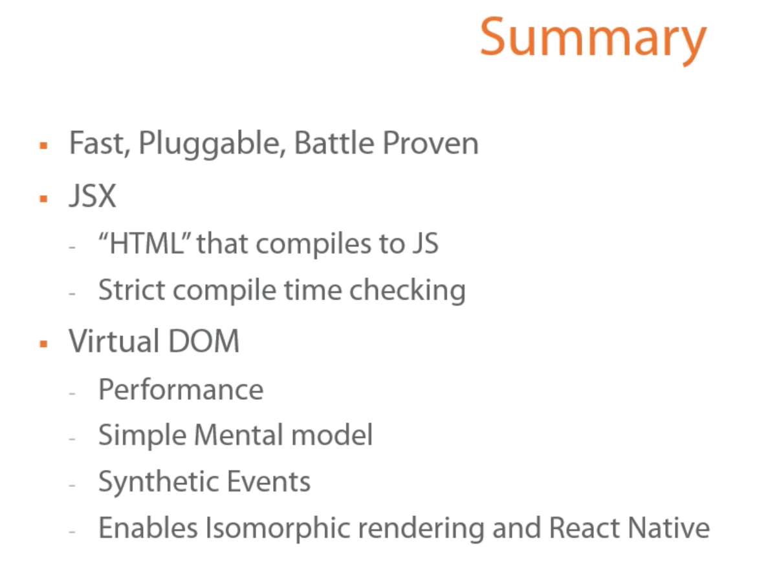

Slide 15
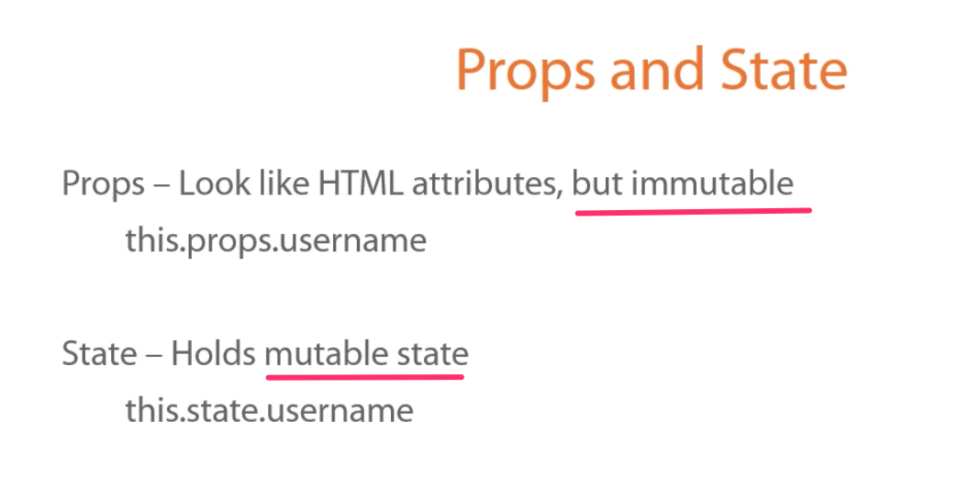


Initialize Default Values here,

Slide 16
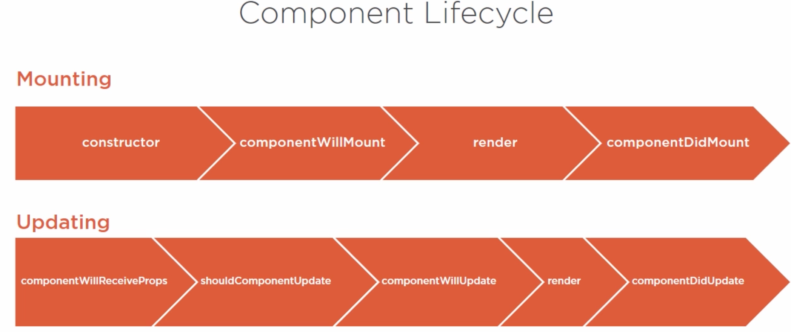

Slide 17
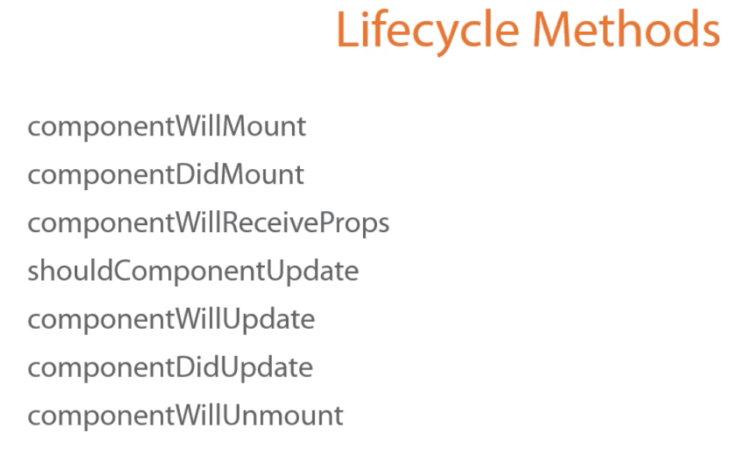

Slide 18
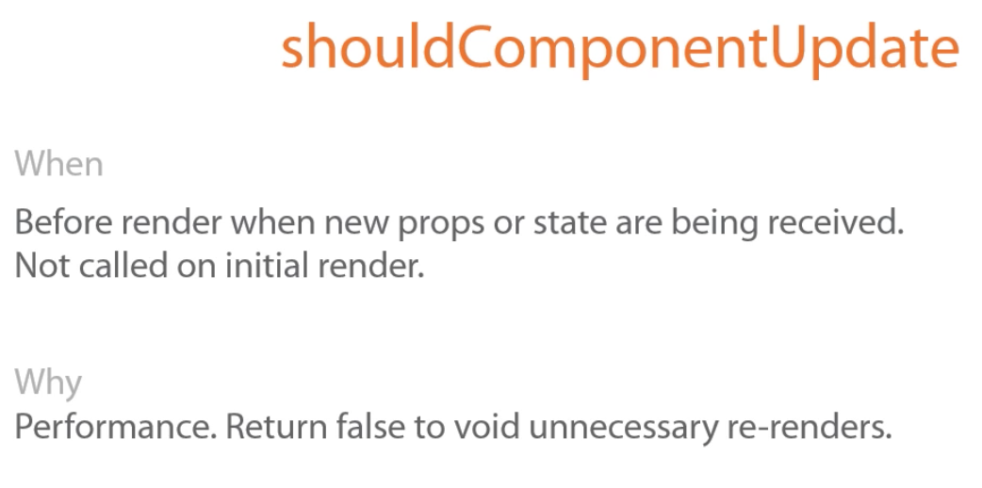
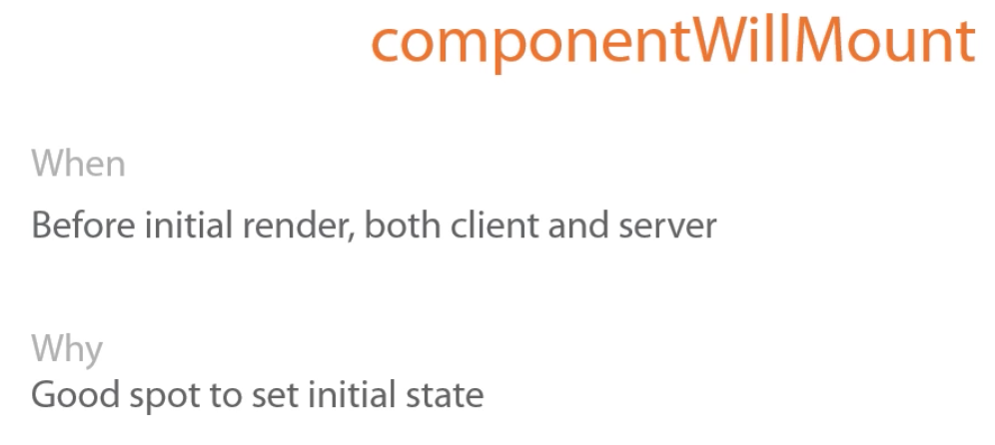
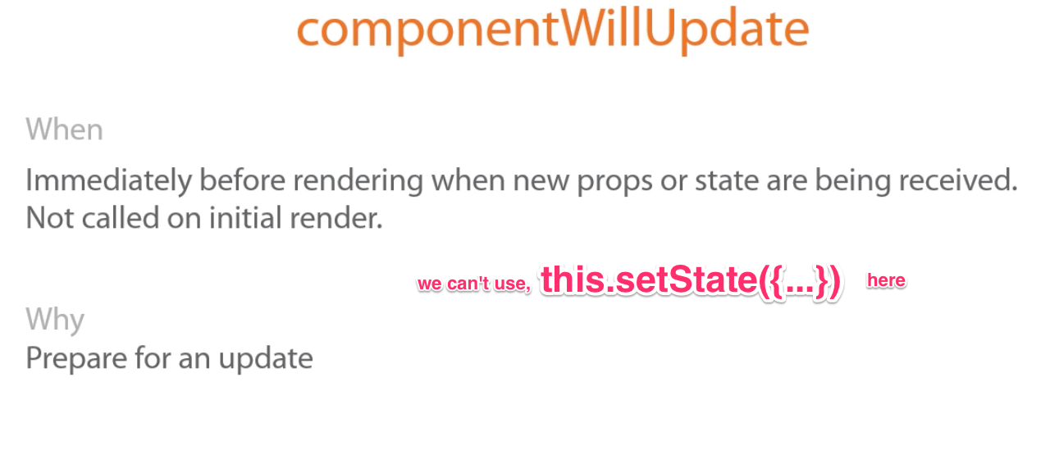
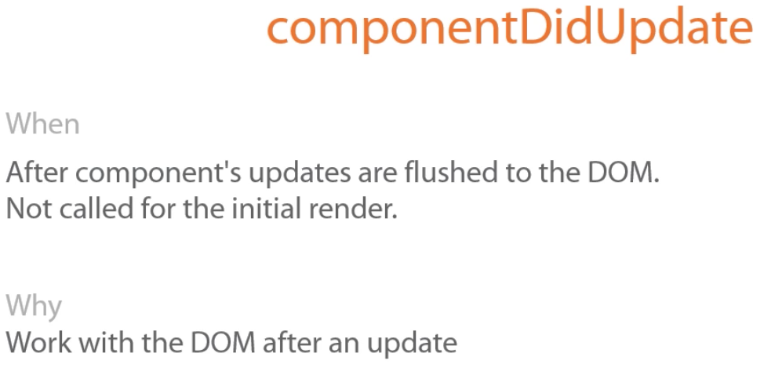
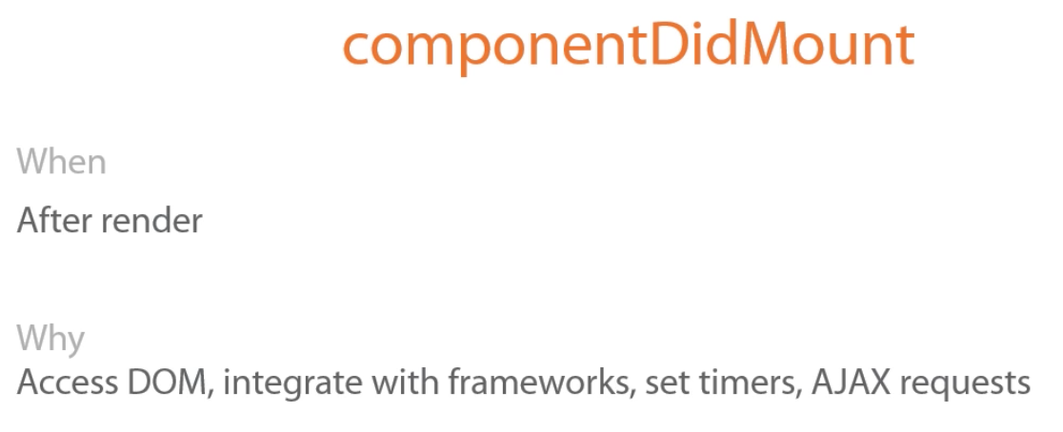
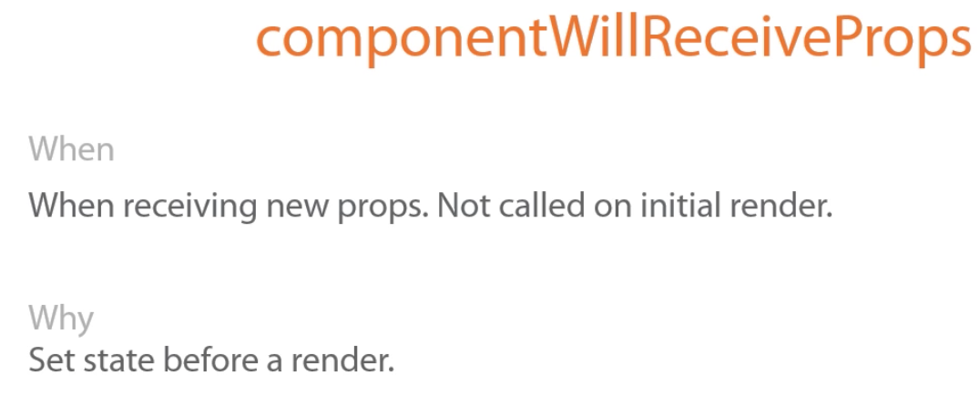
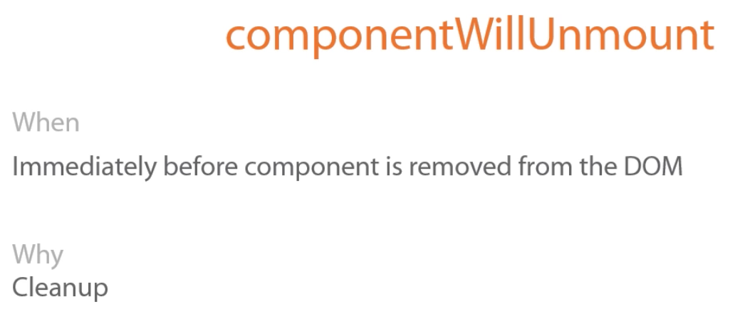
render()

Slide 19
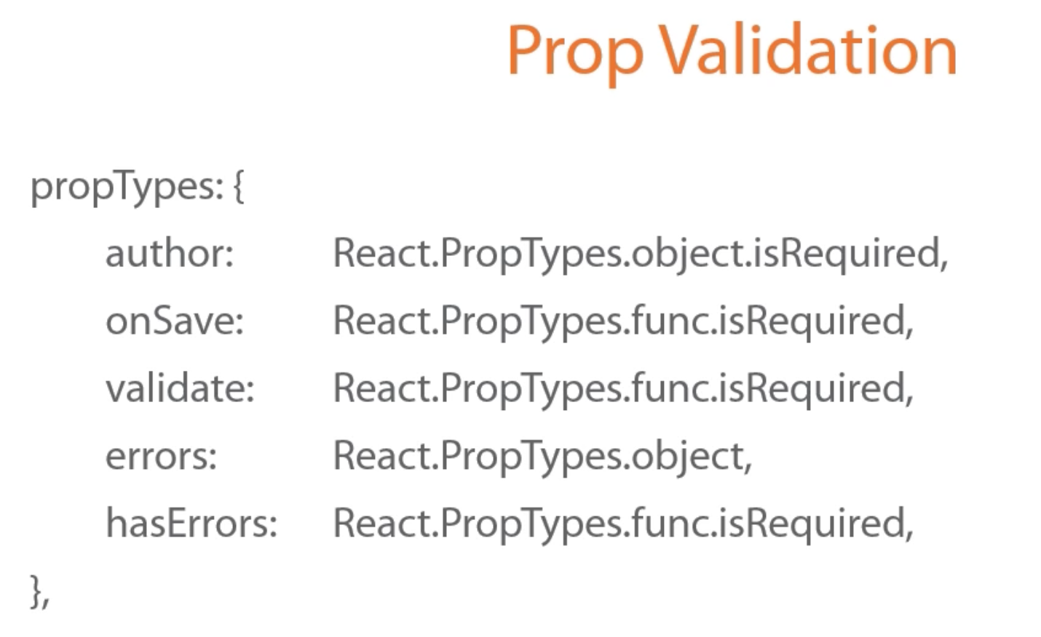

Slide 20
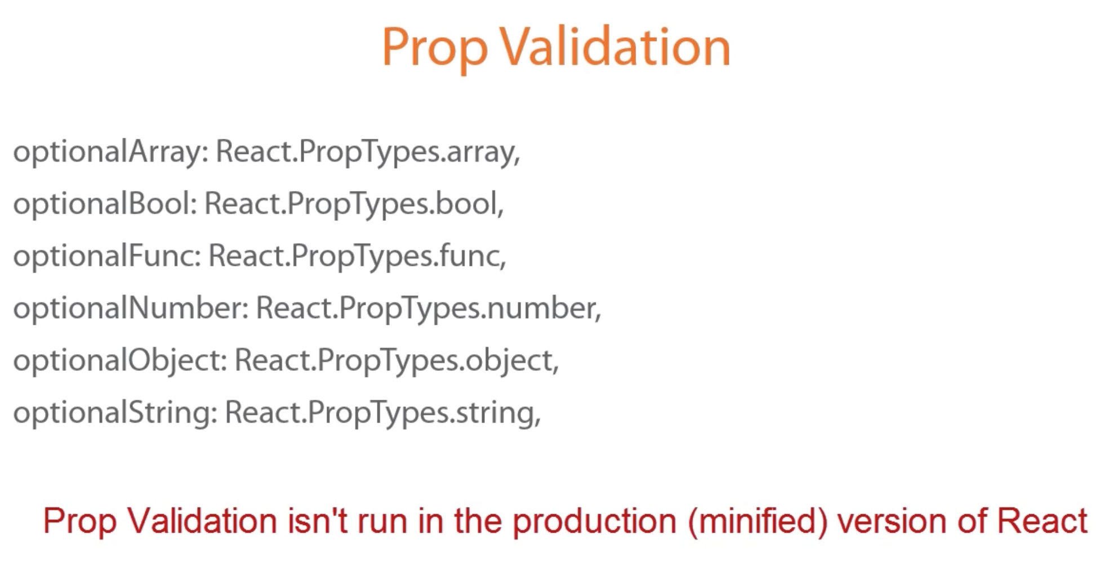

Slide 21


Slide 22
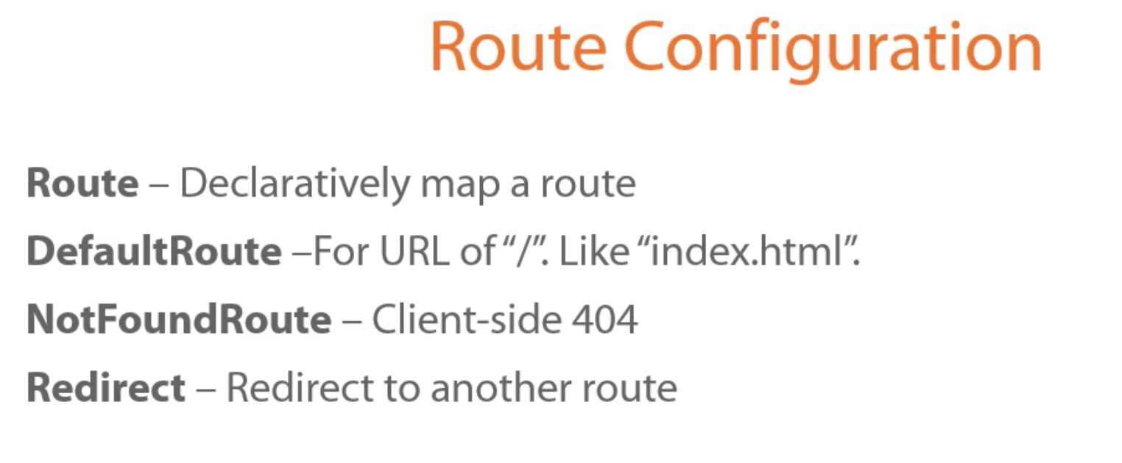

Slide 23
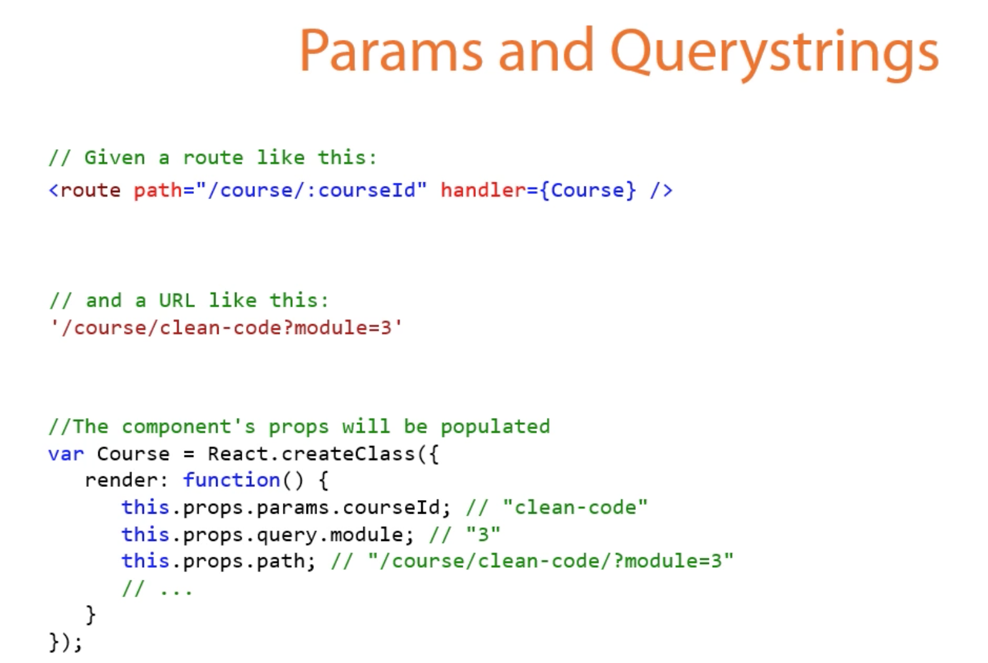

Slide 24
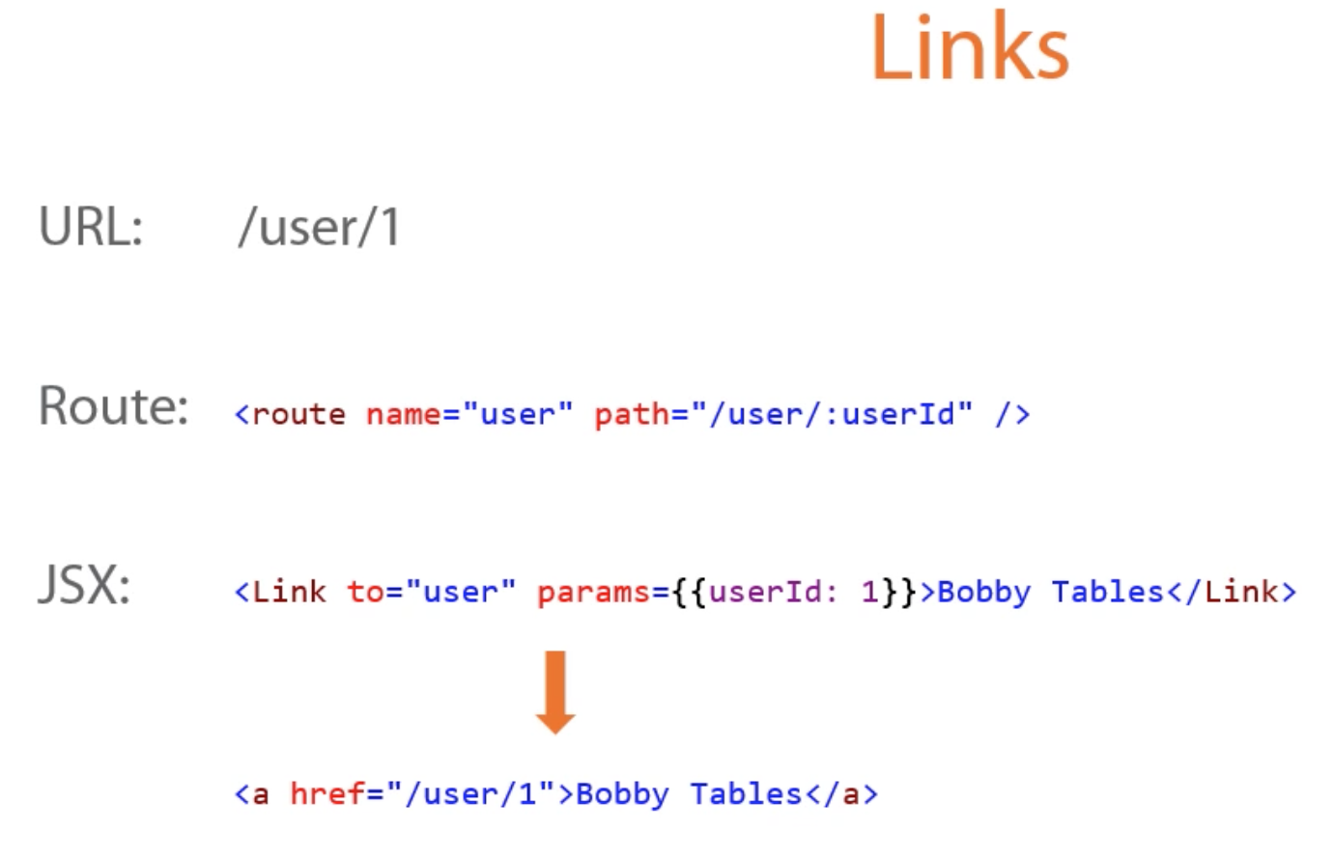

Slide 25
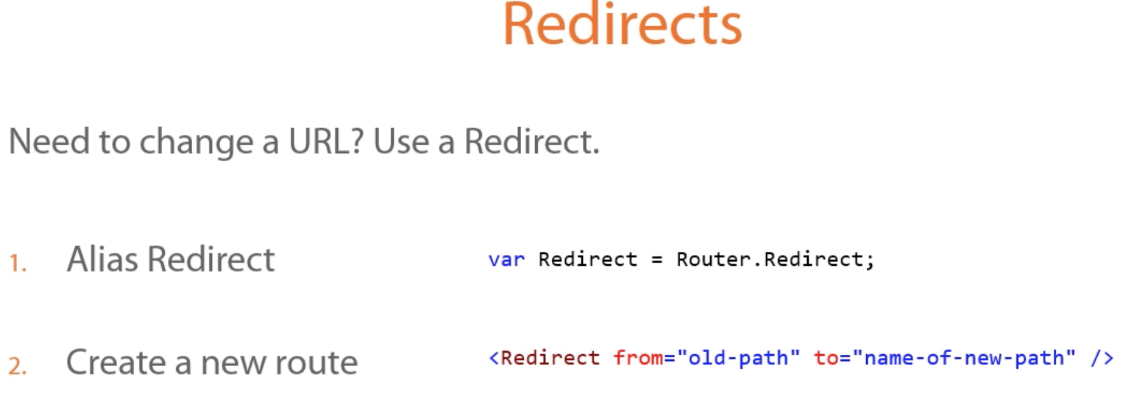

Slide 26
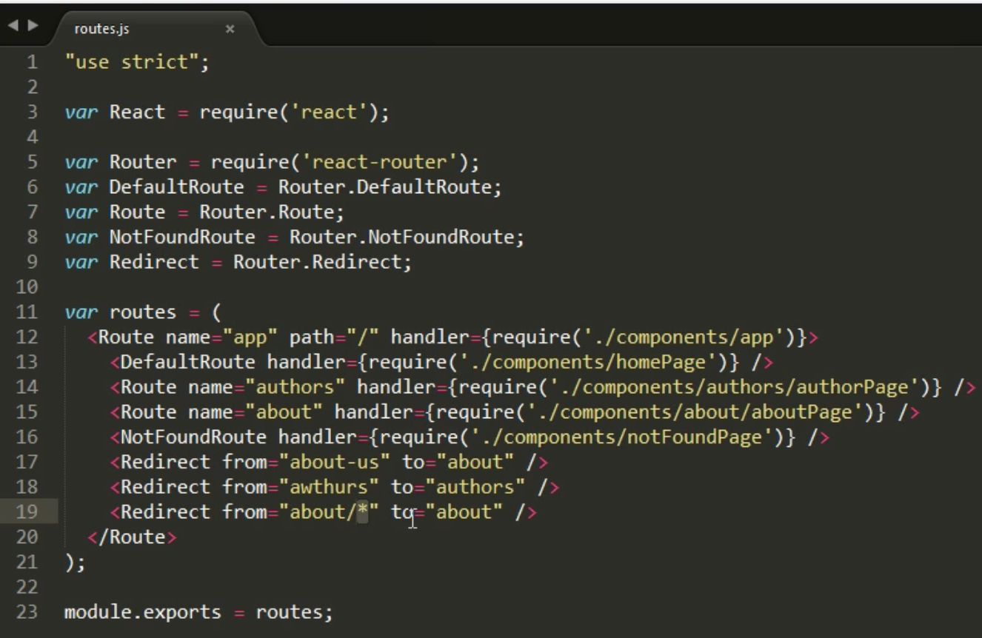
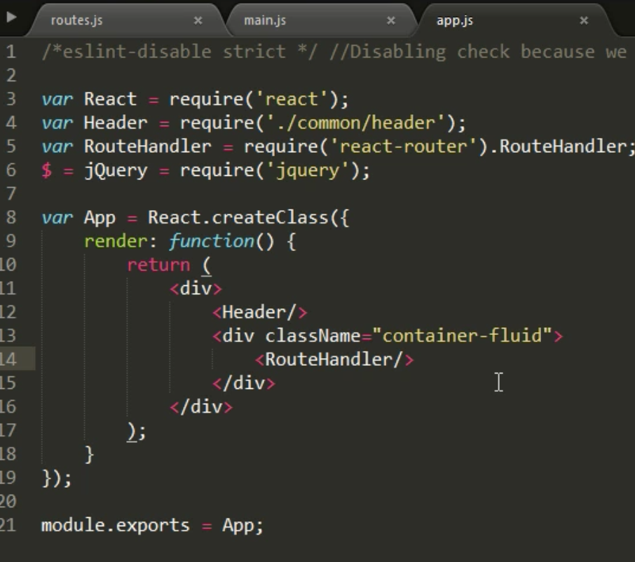
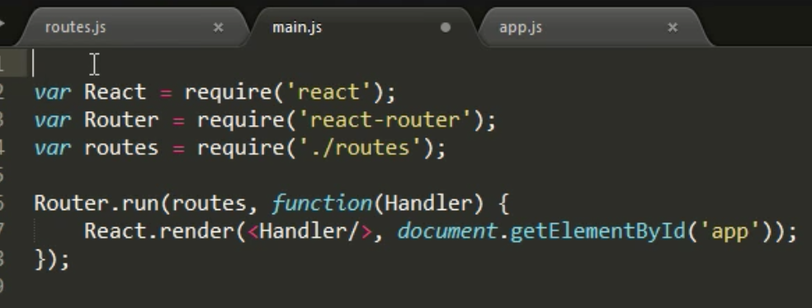

Slide 27
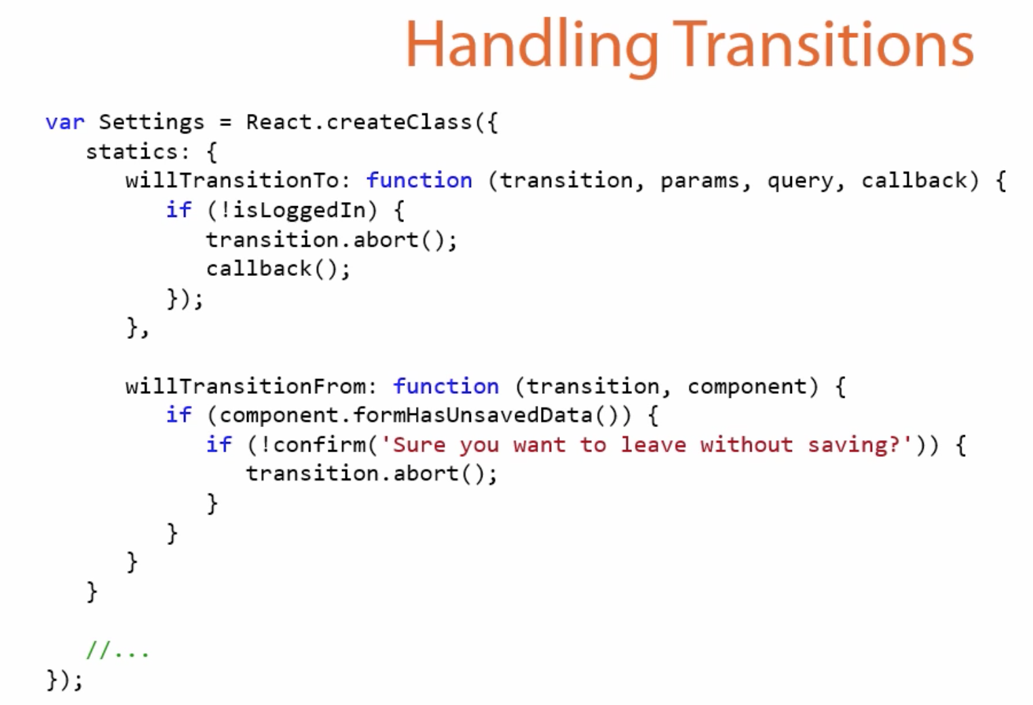
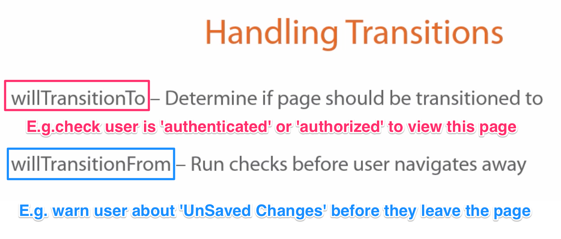

Slide 28
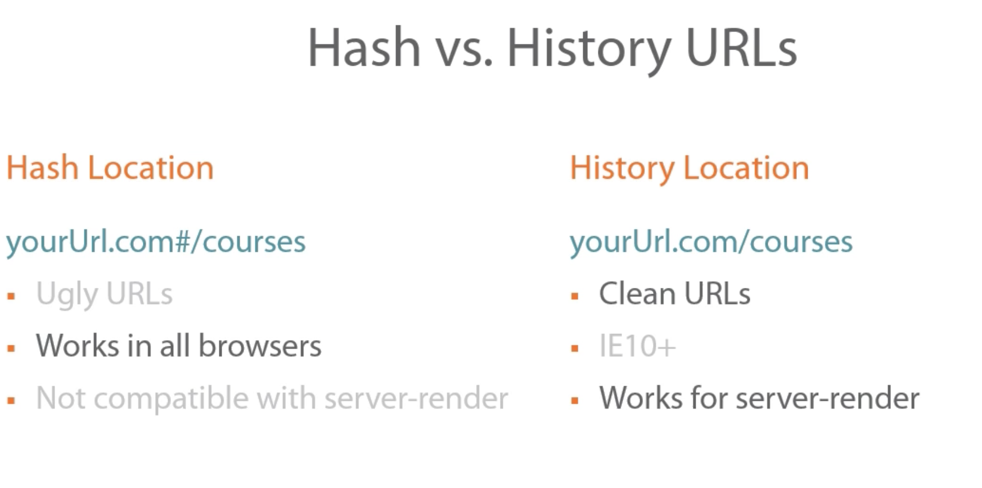

Slide 29
